Slide 1
Training Priors for Task Independent Features with Natural Images

Slide 2
Texture discrimination: learn the transform to ABR space from natural images
mk_rot_mtrx.m
Steps:
Select a 16-bit natural image from, for example, '\CPS Set-9-10-12_16-bit linear’
Convert to double
Normalize all three channels by a single constant so that the max of the three channels to 255
Apply approximate optics of the human eye (aply_otf.m)
Convert to LMS cone space (rgb2lms.m)
Randomly sample 64 x 64 patches (1º x 1º) from each image
Normalize each patch to have an average mean across the 3 channels of value of 128 (ptch_norm.m)
Compile a long list of LMS pixel values by applying steps 1-7 to many images
Apply PCA to this list to obtain the transform (coefficients) to ABR space (pca.m)
Save the transformation matrix (PCA_matrix_3_OTF.mat)

Slide 3
Texture discrimination: learn cdfs for task-independent features from natural images
cdfs_of_features.m
Select a 16-bit natural image from, for example, '\CPS Set-9-10-12_16-bit linear’
Convert to double
Normalize all three channels by a single constant so that the max of the three channels is 255
Apply approximate optics of the human eye (aply_otf.m)
Convert to LMS cone space (rgb2lms.m)
Randomly sample 64 x 64 patches (1º x 1º) from each image
Normalize each patch to have an average mean across the 3 channels of value of 128 (ptch_norm.m)
Transform to ABR space (rot.m), save abr values for color cdfs
Select the A channel, contrast normalize to 0.25 (cntrst_norm.m)
Apply local spatial feature kernels (imgrad.m, imgrad2.m, cen_sur.m), save values for getting spatial cdfs
Repeat from step 1 until all natural images are processed
Compute cdfs (histcnts.m), save cdfs and lms to abr coefficients (‘cdfs_abr_mo13_mo23_cs33_otf.mat’)

Slide 4
Training Task Dependent Features with Natural Images

Slide 5
Texture discrimination: get natural image patches for training
(proximity proxy)
nat_near_far_patches.m
Load cdfs, lms to abr coefficients (‘cdfs_abr_mo13_mo23_cs33_otf.mat’)
Load natural images; convert to double
Apply approximate optics of the human eye (aply_otf.m)
Convert to LMS cone space (rgb2lms.m), down sample for given eccentricity/[lev = 1,2,4,8] (dsmp.m)
Random sample reference patches
For each reference patch form two near pairs and two far pairs
Do this for all image sets, e.g., Set9_16_num.png num = 1:nimg9
Save patch pairs for each image set and desired eccentricity/lev (e.g., ‘patch_pairs_91lev.mat’)

Slide 6
Texture discrimination: learn bins for task-dependent features from natural images
opt_bins_nat.m
Load cdfs and lms to abr coefficients (‘cdfs_abr_mo13_mo23_cs33_otf.mat’)
Load near-far natural image patches
Use the cdf parameters to get the initial bin bounds; e.g., 2 bins = 3 bounds (mk_bins.m)
Find the next bin bound to test (find_bnd.m)
Test the bin bounds including the new bound (test_bnds_nat.m), keep if accuracy exceeds criterion increment
Repeat from step 4 until there are no more bins splits that improve accuracy
Save adaptive histogram equalization (‘AHEO’) bounds (num1 = btype, num2 = dim, num3 = lev)
Can also test and save standard histogram equalization (‘HEO’) bounds

Slide 7
Texture discrimination: train near-far decision variables and bounds 2
(proximity proxy)
nat_near_far_dv_2.m
Load cdfs, lms to abr coefficients (‘cdfs_abr_mo13_mo23_cs33_otf.mat’)
Set level (lev), set bin type (b)
Load patch pairs for each image dataset (e.g., ‘patch_pairs_91lev.mat’) and combine into near and far arrays
Normalize each patch to have an average mean across the 3 channels of value of 128 (ptch_norm.m)
Transform to ABR space (rot.m), same abr values for color cdfs, use A channel only
Load bin bounds for spot and edge features (mk_bb.m)
Compute, power and spot DVs (Rp.m, Rh.m), Rp.m contrast normalizes and Rh.m does for center-surround rfs
Contrast normalization (cntrst_norm.m) and compute, edge DVs (Re.m)
Train spot decision variable (classify_normals.m), save dv coefficients (‘dbndhNOlev.mat’)
Train edge decision variable (classify_normals.m), save dv coefficients (‘dbndeNOlev.mat’)
Train content decision variable (classify_normals.m), save dv coefficients (‘dbndcNOlev.mat’)
Train border decision variable (classify_normals.m), save dv coefficients (‘dbndbNOlev.mat’)
Train border & content decision variable (classify_normals.m), save dv coefficients (‘dbndbcNOlev.mat’)

Slide 8
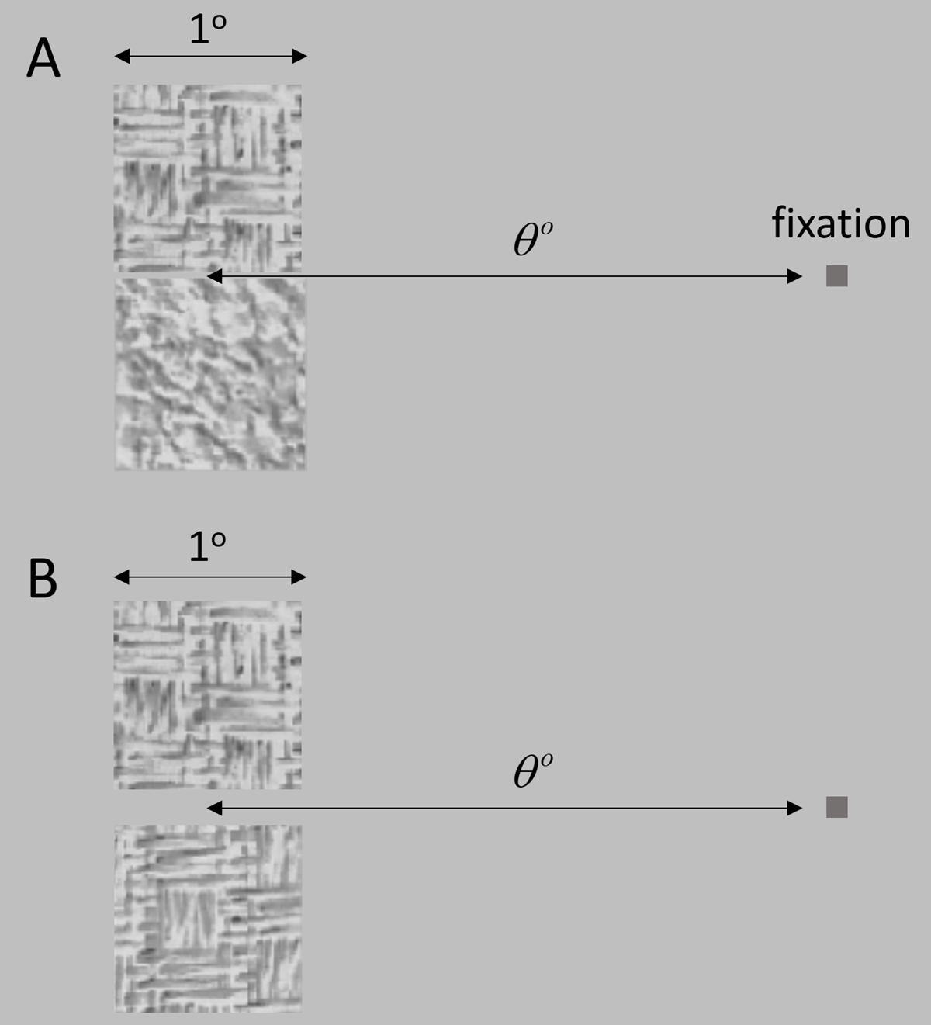
Hierarchical Bayesian Observer (HBO) Model of Texture Discrimination 1
Task Independent Features
Task Specific Features
Spot, Edge & Power DV
Content & Border
DV
Separated & Joined
DV
Joined task
Achromatic pixel
A
S₁
S₂
E₁
E₂
E₃
P
B₁
B₂
DV_{A}
DV_{S1}
DV_{S2}
DV_{E1}
DV_{E3}
DV_{E3}
DV_{P}
DV_{B1}
DV_{B2}
Center-surround small
DV_{S}
DV_{E}
DV_{P}
Separated task
Center-surround large
1st derivative magnitude
2nd derivative magnitude
DV_{C}
DV_{s}
2nd derivative orientation
Power spectrum
DV_{J}
Border edge energy*
DV_{B}
Off-border edge energy*
*uses 1st derivative filter

Slide 9
Texture discrimination: single-image self-supervised bc DV & bound
(proximity proxy)
self_sup_train_bnd_bc.m
Load cdfs, lms to abr coefficients (‘cdfs_abr_mo13_mo23_cs33_otf.mat’)
Set level (lev), set image type (itype), set bin type (b)
Load images; convert to double; for compressed images linearize (adobe_expand.m)
Apply approximate optics of the human eye (aply_otf.m)
Convert to LMS cone space (rgb2lms.m), down sample for given eccentricity/[lev = 1,2,4,8] (dsmp.m)
For the task-dependent features load the number of bins and bin bounds (mk_bb.m)
Load DV coefficients ('dbndhNO’, 'dbndeNO’, 'dbndbNO’, 'dbndcNO’ ) and functions (quad2fun.m)
Generate random texture numbers, masks and maps for all trials in a session (mk_texs.m, mk_masks.m)
For each trial, make the GTR image
Compute all content similarities and mutual similarities (rho values) for the image (mk_phi.m)
Extract and process neighboring patches, normalize ( ptch_norm.m) and transform to abr space (rot.m)
Compute power (Rp.m), spot (Rh.m), dvhfun.m) and edge (Re.m, dvefun.m) decision variables (DVs)
Compute border (Rb.m, dvbfun.m) and content (dvcfun.m) DVs
Compute optimal DV and bound for border and content DV for current trial (classify_normals.m, quad2fun.m)
Notes:
Dynamic bc-bound for each image, fixed general criterion and fixed or dynamic mutual similarity weight.

Slide 10
15. Vary mutual similarity weight (wm) and criterion (gc) parameters; note that when j = 1 and k = 1 wm = gc = 0 and hence no mutual similarity cue (gc should be set to zero when wm is zero)
16. For each set of parameter values compute near-far and same-different accuracy for all near and far pairs from image (dvbcfun.m)
17. Go to step 9
18. Save the average accuracies (pcav) across patch pairs for each set of parameter values (e.g., 40*162 = 6,480 trials)
19. Save average accuracies (pcmav) as a function of criterion when dynamic mutual similarity is used

Slide 11
Texture discrimination: single-image self-supervised bc-shift DV & bound
(proximity proxy)
self_sup_train_bnd_bc_shft.m
Load cdfs, lms to abr coefficients (‘cdfs_abr_mo13_mo23_cs33_otf.mat’)
Set level (lev), set image type (itype), set bin type (b)
Load image images; convert to double; for compressed images linearize (adobe_expand.m)
Apply approximate optics of the human eye (aply_otf.m)
Convert to LMS cone space (rgb2lms.m), down sample for given eccentricity/[lev = 1,2,4,8] (dsmp.m)
For the task-dependent features load the number of bins and bin bounds (mk_bb.m)
Load DV coefficients ('dbndhNO’, 'dbndeNO’, 'dbndbNO’, 'dbndcNO’ , 'dbndbcNO’) and functions (quad2fun.m)
Generate random texture numbers, masks and maps for all trials in a session (mk_texs.m, mk_masks.m)
For each trial, make the GTR image
Compute all content similarities and mutual similarities (rho values) for the image (mk_phi.m)
Extract and process neighboring patches, normalize ( ptch_norm.m) and transform to abr space (rot.m)
Compute power (Rp.m), spot (Rh.m), dvhfun.m) and edge (Re.m, dvefun.m) decision variables (DVs)
Computer border (Rb.m, dvbfun.m) and content ( dvcfun.m) DVs
Notes:
Dynamic border & content decision variable for each image, fixed general criterion and fixed or dynamic mutual-similarity weight.

Slide 12
14. Find opt criterion (copt) for border & content decision variable accuracy
15. Vary mutual similarity weight (wm) and criterion (gc) parameters; note that when j = 1 and k = 1 wm = gc = 0 and hence no mutual similarity cue (gc should be set to zero when wm is zero)
16. For each set of parameter values compute near-far and same-different accuracy for all near and far pairs from image with offset of copt for border & content DV (dvbcfun.m)
17. Go to step 9
18. Save the average accuracies (pcav) across patch pairs for each set of parameter values (e.g., 40*162 = 6,480 trials)
19. Save average accuracies (pcmav) as a function of criterion when dynamic mutual similarity is used
20. Set shftflg = 0 to not use copt

Slide 13
Texture discrimination: single-image self-supervised c-shift DV & bound
(proximity proxy)
self_sup_train_bnd_c_shft.m
Load cdfs, lms to abr coefficients (‘cdfs_abr_mo13_mo23_cs33_otf.mat’)
Set level (lev), set image type (itype), set bin type (b)
Load image images; convert to double; for compressed images linearize (adobe_expand.m)
Apply approximate optics of the human eye (aply_otf.m)
Convert to LMS cone space (rgb2lms.m), down sample for given eccentricity/[lev = 1,2,4,8] (dsmp.m)
For the task-dependent features load the number of bins and bin bounds (mk_bb.m)
Load DV coefficients ('dbndhNO’, 'dbndeNO’, 'dbndbNO’, 'dbndcNO’ , 'dbndbcNO’) and functions (quad2fun.m)
Generate random texture numbers, masks and maps for all trials in a session (mk_texs.m, mk_masks.m)
For each trial, make the GTR image
Compute all content similarities and mutual similarities (rho values) for the image (mk_phi.m)
Extract and process neighboring patches, normalize ( ptch_norm.m) and transform to abr space (rot.m)
Compute power (Rp.m), spot (Rh.m), dvhfun.m) and edge (Re.m, dvefun.m) decision variables (DVs)
Computer border (Rb.m, dvbfun.m) and content ( dvcfun.m) DVs
Notes:
Dynamic content-criterion shift for each image, fixed general criterion and fixed or dynamic mutual-similarity weight.

Slide 14
15. Find opt criterion (copt) for content decision variable accuracy
15. Vary mutual similarity weight (wm) and criterion (gc) parameters, note that when j = 1 and k = 1 wm = gc = 0 and hence no mutual similarity cue (gc should be set to zero when wm is zero)
16. For each set of parameter values compute near-far and same-different accuracy for all near and far pairs from image with offset of copt for content DV (dvbcfun.m)
17. Go to step 9
18. Save the average accuracies (pcav) across patch pairs for each set of parameter values (e.g., 40*162 = 6,480 trials)
19. Save average accuracies (pcmav) as a function of criterion when dynamic mutual similarity is used
20. Set bordflg = 0 to not use border cues
21. Set shftflg = 0 to not use copt

Slide 15
Methods with fixed final same-different decision criterion (biologically plausible)
N = trained on natural images using proximity proxy for ground truth
NC = N with content criterion adjusted for the current image using the proximity proxy
NMF = N with mutual similarity and fixed weight using the proximity proxy
NM = N with the mutual similarity weight adjusted for current image using the proximity proxy
NCM = N with content criterion and mutual similarity weight adjusted for current image using the proximity proxy
Methods with dynamic final same-different decision criterion (less plausible)
NCB = N with content and border criterion adjusted using proximity proxy for ground truth
NCBM = N with content and border criterion and mutual similarity weight adjusted for the current image using the proximity proxy

Slide 16
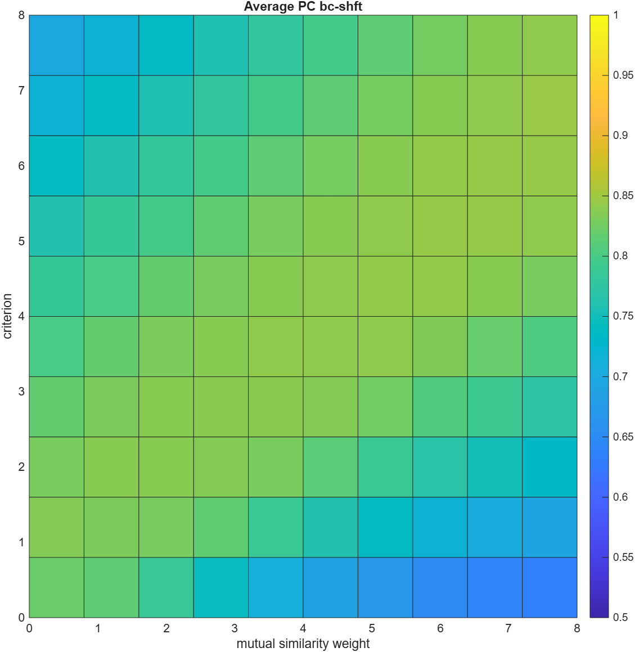

Slide 17
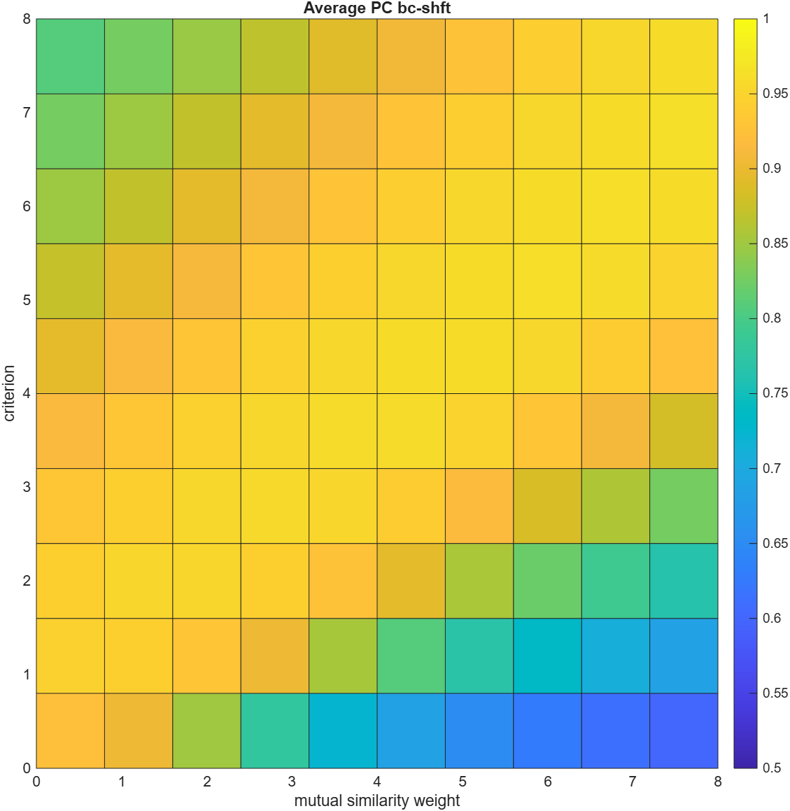

Slide 18
Hierarchical Bayesian Observer (HBO) Model of Texture Discrimination 2
Task Independent Features
Task Specific Features
Spot, Edge & Power DV
Content & Border
DV
Separated & Joined
DV
Joined task
Achromatic pixel
A
S₁
S₂
E₁
E₂
E₃
E₄
P
B₁
B₂
DV_{A}
DV_{S1}
DV_{S2}
DV_{E1}
DV_{E2}
DV_{E3}
DV_{E4}
DV_{P}
DV_{B1}
DV_{B2}
Center-surround small
DV_{S}
DV_{E}
DV_{P}
Separated task
Center-surround large
1st derivative magnitude
1st derivative m x o
DV_{C}
DV_{s}
2nd derivative magnitude
2nd derivative orientation
DV_{J}
Power spectrum
Border edge energy*
DV_{B}
Off-border edge energy*
*uses 1st derivative filter

Slide 19
Application to GTR Texture Segmentation

Slide 20
Texture segmentation: NCBM
tex_grp_s_p_ms_SS_ncbm.m
Load cdfs, lms to abr coefficients (‘cdfs_abr_mo13_mo23_cs33_otf.mat’)
Set level (lev), set image type (itype), set bin type (b)
Load image images; convert to double; for compressed images linearize (adobe_expand.m)
Apply approximate optics of the human eye (aply_otf.m)
Convert to LMS cone space (rgb2lms.m), down sample for given eccentricity/[lev = 1,2,4,8] (dsmp.m)
For the task-dependent features load the number of bins and bin bounds (mk_bb.m)
Load DV coefficients ('dbndhNO’, 'dbndeNO’, 'dbndbNO’, 'dbndcNO’ , 'dbndbcNO’) and functions (quad2fun.m)
Set random seed for a trial
Generate random texture numbers, masks and maps the trial (mk_texs.m, mk_masks.m)
For each trial, make the GTR image
Compute all content similarities and mutual similarities (rho values) for the image (mk_phi.m)
Extract and process neighboring patches, normalize ( ptch_norm.m) and transform to abr space (rot.m)
Compute power (Rp.m), spot (Rh.m), dvhfun.m) and edge (Re.m, dvefun.m) decision variables (DVs)
Computer border (Rb.m, dvbfun.m) and content ( dvcfun.m) DVs
Notes:
Dynamic content-criterion shift for each image, fixed general criterion and fixed or dynamic mutual-similarity weight.

Slide 21
14. Find opt criterion (copt) for border & content decision variable accuracy
15. Vary mutual similarity weight (wm) and criterion (gc) parameters; note that when j = 1 and k = 1 wm = gc = 0 and hence no mutual similarity cue (gc should be set to zero when wm is zero)
16. For each set of parameter values compute near-far and same-different accuracy for all near and far pairs from image with offset of copt for border & content DV (dvbcfun.m)
17. Save parameter values that give maximum near-far accuracy
18. Vary the three grouping decision criteria dgc, cc, and mc to maximize region count (mk_groups.m, reg_count.m)
19. Go to step 8

Slide 22
Texture segmentation: NCM
tex_grp_s_p_ms_SS_ncm.m
Load cdfs, lms to abr coefficients (‘cdfs_abr_mo13_mo23_cs33_otf.mat’)
Set level (lev), set image type (itype), set bin type (b)
Load image images; convert to double; for compressed images linearize (adobe_expand.m)
Apply approximate optics of the human eye (aply_otf.m)
Convert to LMS cone space (rgb2lms.m), down sample for given eccentricity/[lev = 1,2,4,8] (dsmp.m)
For the task-dependent features load the number of bins and bin bounds (mk_bb.m)
Load DV coefficients ('dbndhNO’, 'dbndeNO’, 'dbndbNO’, 'dbndcNO’ , 'dbndbcNO’) and functions (quad2fun.m)
Set random seed for a trial
Generate random texture numbers, masks and maps the trial (mk_texs.m, mk_masks.m)
For each trial, make the GTR image
Compute all content similarities and mutual similarities (rho values) for the image (mk_phi.m)
Extract and process neighboring patches, normalize ( ptch_norm.m) and transform to abr space (rot.m)
Compute power (Rp.m), spot (Rh.m), dvhfun.m) and edge (Re.m, dvefun.m) decision variables (DVs)
Computer border (Rb.m, dvbfun.m) and content ( dvcfun.m) DVs
Notes:
Dynamic content-criterion shift for each image, fixed general criterion and fixed or dynamic mutual-similarity weight.

Slide 23
14. Find opt criterion (copt) for content decision variable accuracy
15. Vary mutual similarity weight (wm) and criterion (gc) parameters; note that when j = 1 and k = 1 wm = gc = 0 and hence no mutual similarity cue (gc should be set to zero when wm is zero)
16. For each set of parameter values compute near-far and same-different accuracy for all near and far pairs from image with offset of copt for border & content DV (dvbcfun.m)
17. Save parameter values that give maximum near-far accuracy
18. Vary the three grouping decision criteria dgc, cc, and mc to maximize region count (mk_groups.m, reg_count.m)
19. Go to step 8

